Slide 1


Patrick Connell, Ph. D.
Email: connell.patrick@gmail.com
March 29th, 2026

Slide 2

Outline/Table of Contents
Executive Summary
Introduction
Methodology
Results
Conclusion
Acknowledgements
References
Appendix

Slide 3
Executive Summary
The aim of this report is to communicate the findings of an investigation into whether or not we can predict a successful launch of the first stage of the SpaceX Falcon 9 rocket, and what factors are important to a successful launch.
The methodologies used were an API call to get the data, Webscraping the SpaceX wikipage, and Data wrangling. Exploratory data analysis was performed by implementing data visualization and an SQL search of the data. A Folium map on a subset of the data was created to show where the launches occurred and how successful they were. A Plotly dashboard was built to provide an interactive pie chart to indicate the percentage of successful launches by site, and a percentage breakdown of launches at each site. A scatter plot of the launch class (success = 1, failure = 0) against payload was constructed with a slider range between 0 kg and 10,000 kg, with the booster version used in the launch indicated by the hue of the points on the scatter plot. The most successful launches occurred between 1,000 kg and 6,000 kg with the predominant booster being the F9 FT booster. Other boosters, such as B4 and B5, were also successful but not to the degree of the FT booster. Logistic Regression (LR), Support Vector Machine (SVM), Decision Tree (DT), and K-Nearest Neighbour (KNN) classifiers were implemented, and a Grid Search pipeline was applied to find the hyperparameters. It was found surprisingly that the LR, SVM, DT and KNN all returned the same accuracy score of 0.8333. However, the DT returned an accuracy score of 0.67, 0.72 or 0.94 on some runs of the code. So, the DT classifier seems unreliable. This is probably due to a lack of data. It wasn’t possible to determine the cost of the launches because no data in relation to costs was provided.

Slide 4
Introduction
The aim of this project was to predict if the first stage of the Falcon 9 rocket will land successfully. SpaceX advertise that the cost of a successful launch is 62 million $US, whereas the cost of a launch by other providers is above 165 million $US. The savings that SpaceX obtain is due to the re-use of the first stage.
This investigation aims to find the answers to the following problems:
  What factors/features go into a successful launch, and what is the cost of a successful launch?

Slide 5

Section 1

Slide 6
Methodology
Executive Summary
Data collection methodology:
  The methods used to collect the data is described
Perform data wrangling
  How the data was processed is described
Perform exploratory data analysis (EDA) using visualization and SQL
Perform interactive visual analytics using Folium and Plotly Dash
Perform predictive analysis using classification models
  How to build, tune, evaluate classification models

Slide 7
Data Collection
The SpaceX launch data was requested and parsed using a GET request. This was done using the SpaceX REST API.
Falcon 9 data was also obtained using web scraping techniques applied to the Wikipedia pages for Falcon 9.
The data collection processes are present in the next two slides using key phrases and flowcharts.

Slide 8
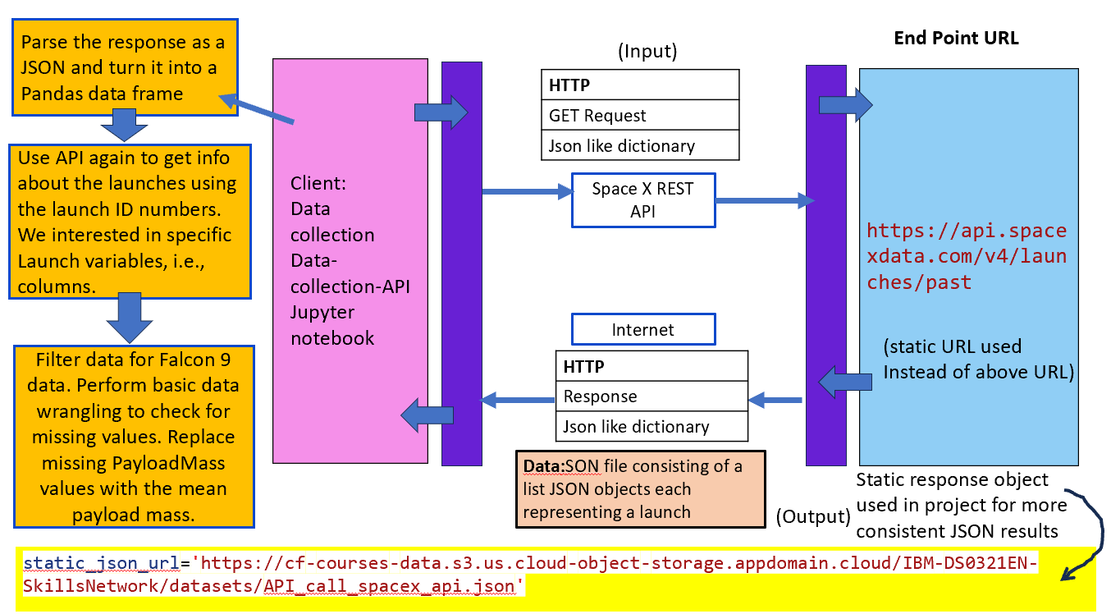
Data Collection – SpaceX API
A HTTP GET Request is made via
a JSON like dictionary using the
SpaceX API to the SpaceX data
past launches web server.
Launch data is returned via the
internet in response. The data is
in a JSON file consisting of a list
of JSON objects – one for each
launch.
Parse the response object.
Use API again to specific information
using launch ID numbers
Filter data for Falcon 9 data. Perform
basic data wrangling to check for missing
values. For a given variable replace
these with the mean.
GitHub URL: Data Collection API Jupyter notebook

Slide 9
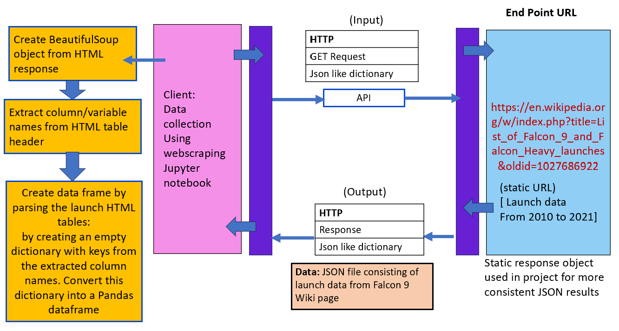
Data Collection - Scraping
A HTTP GET request is sent to a static URL. The URL is the Falcon 9 Wiki page.
A BeautifulSoup object is then created from the HTML response.
Column/variable names are extracted from the HTML table headers.
A Pandas DataFrame of the launch date is created by parsing the launch HTML tables
GitHub URL:
webscraping_Jupyter_notebook_on_GitHub

Slide 10
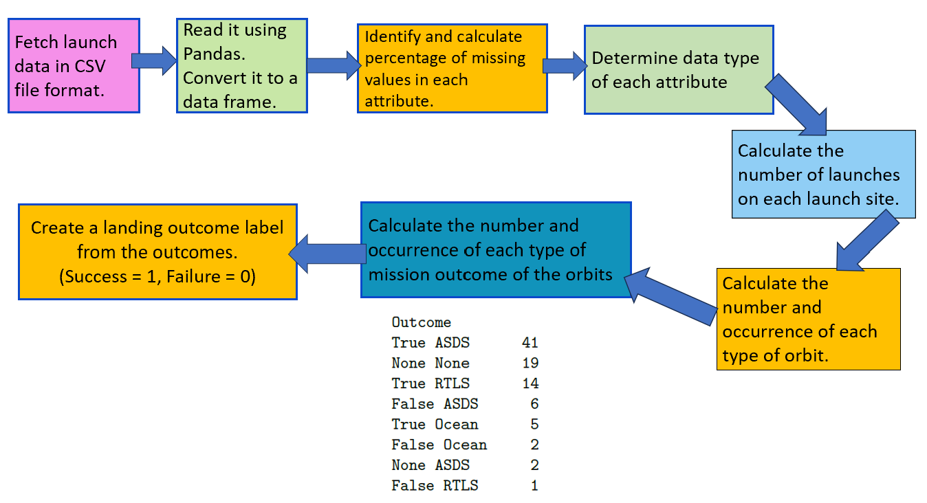
Data Wrangling
Main objectives:
  Exploratory Data Analysis.
  Determine training labels on
  outcomes.
GitHub URL: Data wrangling file

Slide 11
EDA with Data Visualization
The following charts were plotted as part of the exploratory data analysis
  Payload Mass versus Flight Number
  Launch Site versus Flight Number
  Launch Site versus Payload Mass
  A histogram of mean success for each orbit type
  Orbit versus Flight Number
  Orbit versus Payload Mass
  Average Success Rate versus Year (Average launch success trend)
GitHub URL: EDA_data_vizualization

Slide 12
EDA with Data Visualization
The charts plotted were chosen because it was desired to
  Know the relationship between Payload Mass and Flight Number,
  Know how Flight Number and Payload Mass affect the launch outcome,
  Learn the association between Flight Number and Launch Site,
  Understand how Payload Mass varies according to Launch Site,
  Determine the Average Success Rate of each Orbit type,
  Learn the relationship (if any) between Flight Number and orbit type (Orbit),
  Understand the relationship between Payload Mass and Orbit type,
  Learn if launches became more successful each year by plotting the Average Yearly Success Rate.

Slide 13
EDA with SQL
Firstly, an SQL query was made to create a table where Date is not null
Then an SQL query was made to select all distinct launch sites.
A query was made to display 5 records where the launch site begins with the string "KSC"
The total payload mass in kg carried by boosters launched the customer were NASA (CRS) were selected and the sum total was calculated.
An SQL query was made to select the average payload mass for the F9 v1.1 booster
The date of the first successful landing on a drone ship was selected.
The names of boosters that successfully landed on a ground pad/drone ship and have payload mass greater than 4,000 kg and less than 6,000 kg were selected.

Slide 14
EDA with SQL
A query was made to count the number of successful mission outcomes and to count the number of failures.
An SQL subquery was used to list all the distinct boosters that carried the maximum payload mass.
An SQL query was made to select the day, month (1-12), and booster version of successful ground pad landing outcomes for the year 2017.
An SQL query was made to rank the count of landing outcomes both success and failure for each type of landing option, e.g., drone ship or ground pad, between the dates 2010-06-04 and 2017-03-20. The rank was in descending order.
GitHub URL of completed EDA with SQL notebook: Completed SQL EDA Jupyter notebook

Slide 15
Build an Interactive Map with Folium
A circle and a (map) marker was added to the Folium map to indicate the coordinates, i.e., the location, of each launch site.
A (pop-up) marker was added to indicate the launch record for each individual launch at each launch site. Many of these had the same coordinates since different launches occurred at the same launch site. Successful launches were labelled green and failures were labelled red.
A (plain) marker was added to the map for the estimated nearest proximities to a chosen launch site (e.g. I chose Space Launch Complex 4 East at Vandenberg Space Force Base (VAFB SLC-4E)): e.g., railway, city, highway, airport, coastline. A line was added to the Folium map from the launch site to each of the proximities and the (plain) marker for a given proximity was expressed in terms of the distance from the launch site to the proximity.
GitHub URL of completed interactive map with Folium map: Interactive Map

Slide 16
Build an Interactive Map with Folium
These were chosen because given a launch site it is important to know the distance to proximities. The reasons being that launch sites are in close proximity
to railways so that materials can be brought to them.
to highways so that materials can be brought to them and that medical teams can reach them if necessary.
to a coastline so that the rockets are launched over the sea away from population centres, e.g., cities.
cities are kept a certain distance away from launch sites to reduce risk to human population and because cities would not have the space to build the launch sites, but also because the workers live in the cities and don't want to travel long distances to work.
GitHub URL of completed interactive map with Folium map: Interactive Map

Slide 17
Build a Dashboard with Plotly Dash
A dashboard with a drop-down list to interact with a pie chart and a scatter point chart with a slide ranger that shows how class, i.e., launch success or failure, depended on payload mass and booster version were constructed.
For the pie chart one could choose "All Sites" which shows a pie chart with the overall percentage of successful and unsuccessful launches, or one could choose from the launch sites to show the percentage of successful and unsuccessful launches at the chosen site.
For the range slider, a scatter point plot of "class" (i.e., success (1) or failure (0) )was plotted against payload mass for "All Sites" or the launch site chosen from the drop-down list, with the booster version being colour-coded.

Slide 18
Build a Dashboard with Plotly Dash
These were plotted to see more easily which launch site had more successes and how the success/failure, i.e., the class depended on the payload mass and the booster version.
The dashboard helps perform a visual analysis, and assists in providing insight to answer some of the following questions:
  "Which site has the largest successful launches?"
  Which site has the highest launch success rate?"
  "Which payload range(s) has the highest launch success rate?"
  "Which payload range(s) has the lowest launch success rate?"
  "Which F9 Booster version (v1.0, v1.1, FT, B4, B5) has the highest launch success rate?"
GitHub URL: Interactive Dashboard

Slide 19
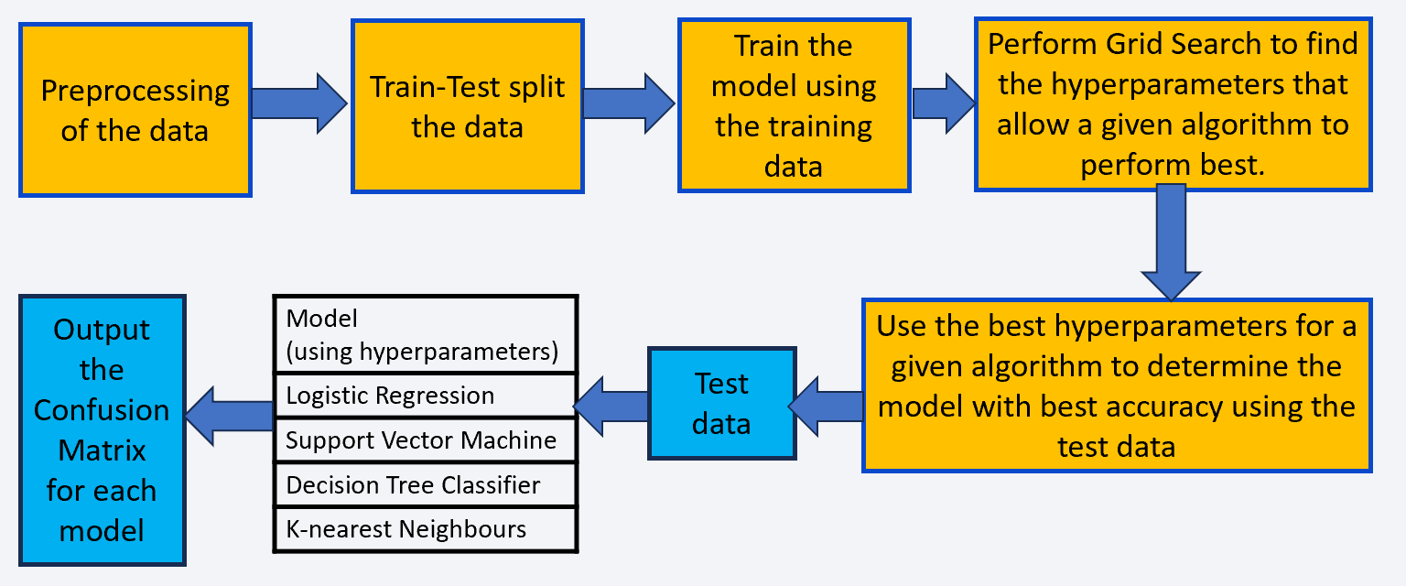
Predictive Analysis (Classification)
Preprocess the data.
Split the data into training and test sets.
Train the models using the training data.
Perform Grid Search to find the hyper-
parameters that allow a given algorithm
to perform best.
Using the hyperparameters, determine the accuracy
of each model (Logistic Regression, Support
Vector Machines, Decision Tree Classifier,
K-Nearest Neighbours) by using the test data set.
Finally, the confusion matrix for each model was outputted.
GitHub link: Predictive Analysis

Slide 20
Results
Exploratory data analysis results
Interactive analytics demo in screenshots
Predictive analysis results

Slide 21

Section 2

Slide 22
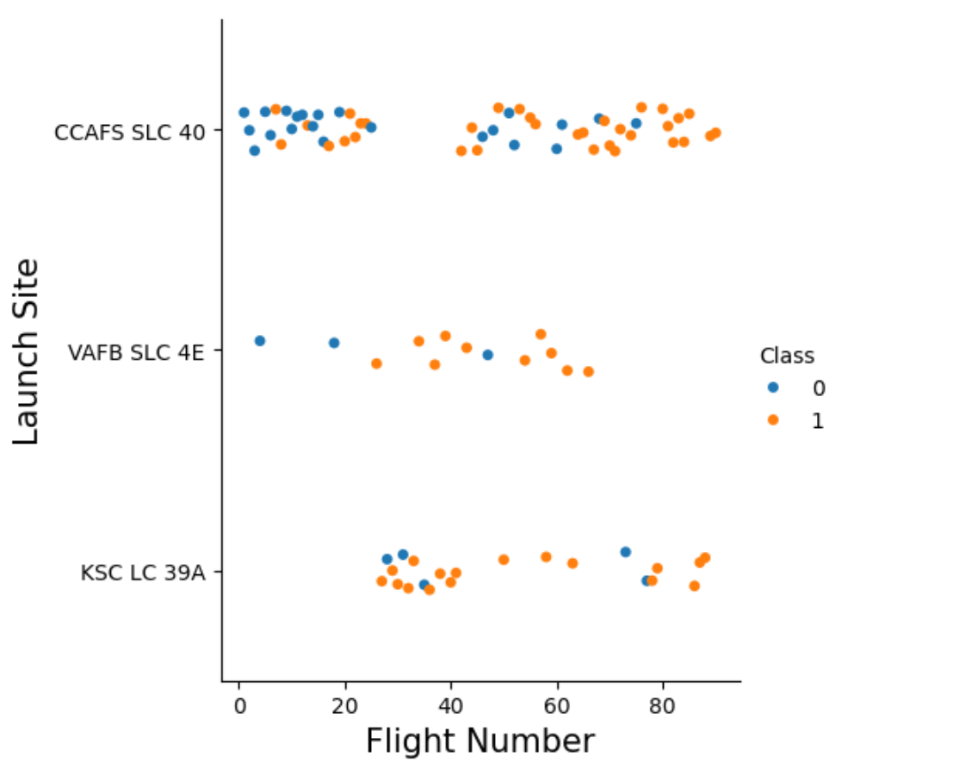
Flight Number vs. Launch Site
A scatter plot of Flight Number vs. Launch Site (or Launch Site vs. Flight Number)

Slide 23
Flight Number vs. Launch Site
Generally, as the flight number increased the launches at each site became more successful (class = 1).
However, even as flight number increased there were unsuccessful launches (class = 0).
Launch failure even at large or small flight number suggests there are contributing factors to a successful launch that are not dictated by increasing the flight number.

Slide 24
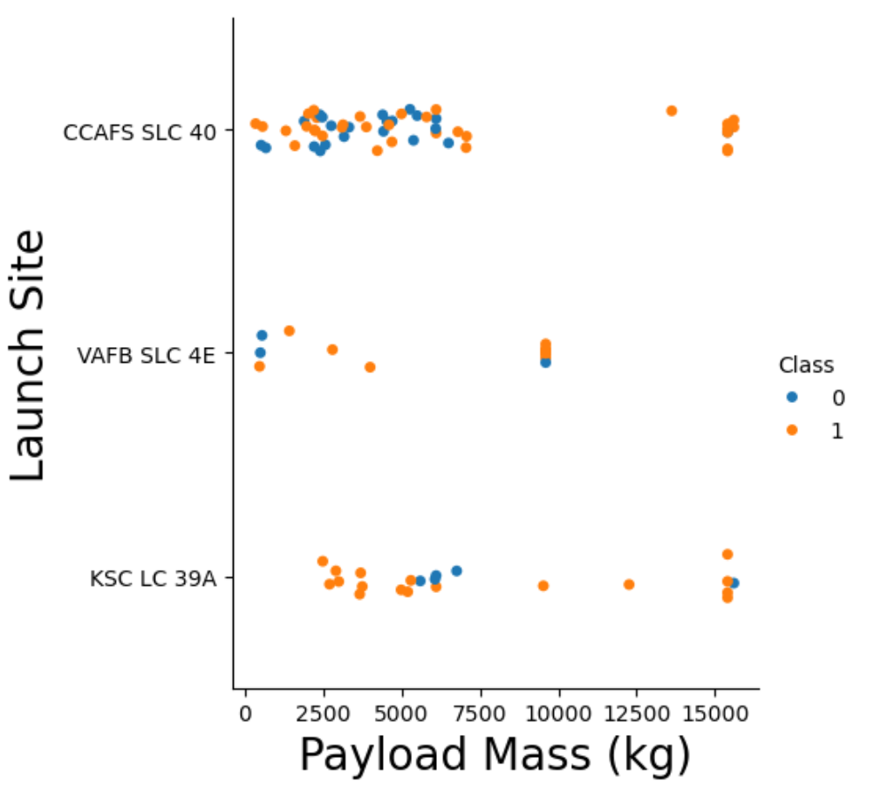
Payload vs. Launch Site
A scatter plot of Payload vs. Launch Site
Show the screenshot of the scatter plot with explanations

Slide 25
Payload vs. Launch Site
There are no launches at VAFB with payloads above 10, 000 kg. There are unsuccessful launches for small payloads and at max payload at VAFB.
All launches at CCAFS SLC
40 with payloads above approximately 6, 000 kg are successful. Unsuccessful launches occur at masses below ~ 6,000 kg.
At the KSC site unsuccessful launches occur for payloads between 5,000 kg and 7,500 kg, and one occurs at around 15,600 kg.
The fact that launch failures occur suggests payload may not be the predominant feature responsible for failed launches.

Slide 26
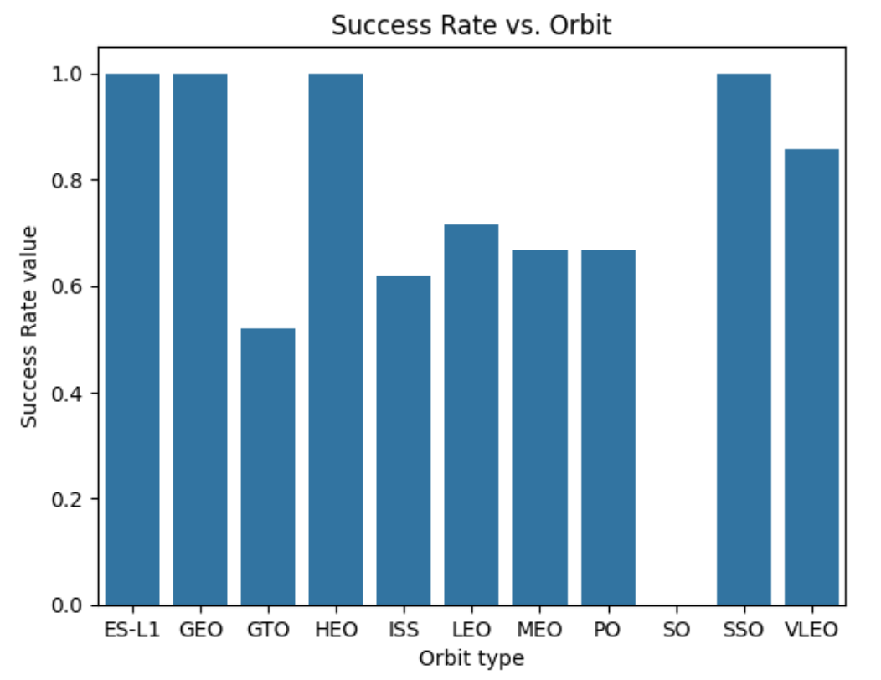
Success Rate vs. Orbit Type
A bar chart for the success rate for each orbit type.

Slide 27
Success Rate vs. Orbit Type
The most successful launches were 'ES-L1', 'GEO', 'HEO' and 'SSO.'
GTO was the very unsuccessful
SO orbits have a success rate of 0.

Slide 28
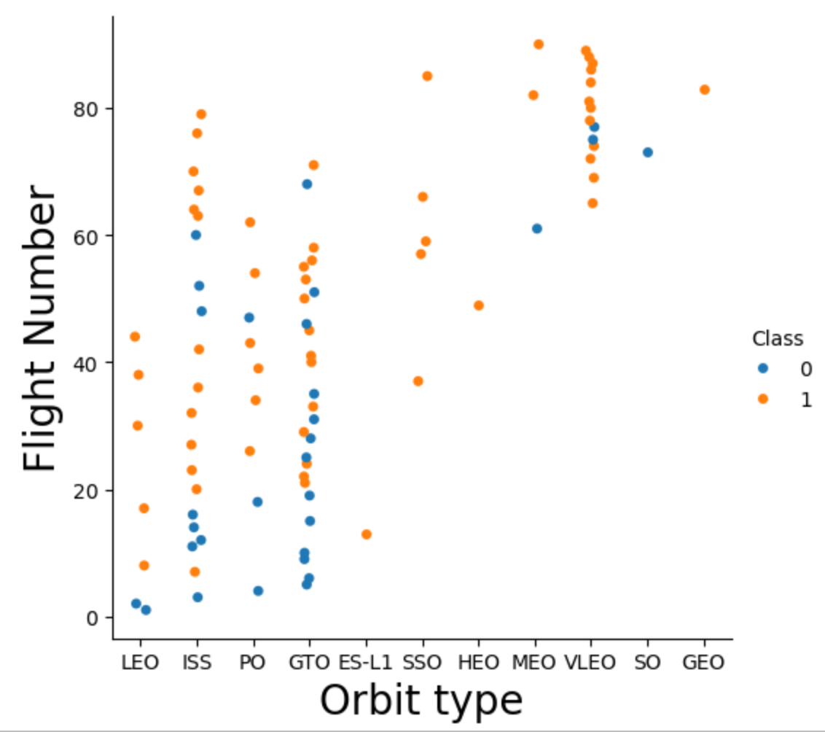
Flight Number vs. Orbit Type
Shown on the right is a scatter point of Flight Number vs. Orbit type.

Slide 29
Flight Number vs. Orbit Type
Clearly the launches for some orbit types are more successful than others.
Some have nearly a 100% success rate, e.g., LEO, VLEO and ES-L1.
The success of ES-L1 orbits is deceptive since there was only such orbit.

Slide 30
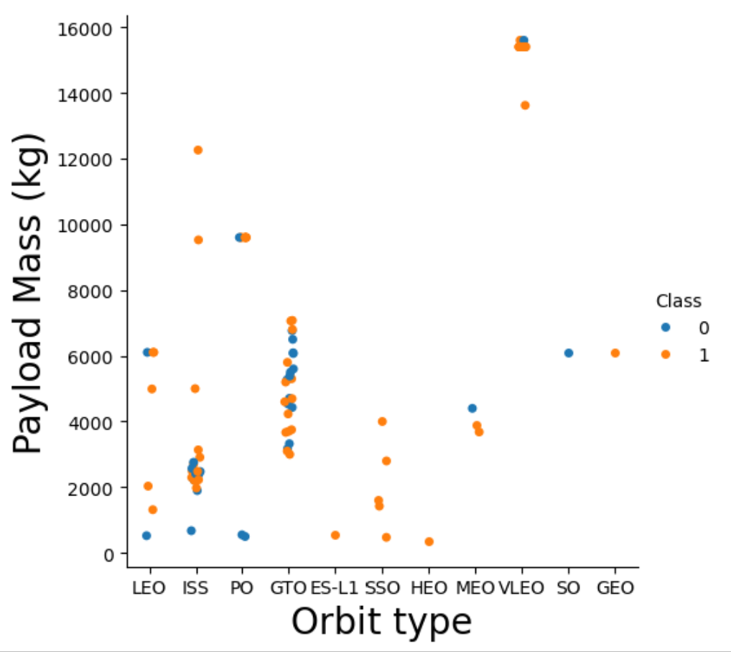
Payload vs. Orbit Type
A scatter point plot of Payload vs. Orbit Type is shown in the figure on the right.

Slide 31
Payload vs. Orbit Type
The SSO orbits are successful independent of Payload Mass.
The lone launches of ES-L1, HEO and GEO were successful. This doesn’t appear to be correlated to the payload value.
The success of ISS orbits is somewhat independent of the payload mass.
The success of GTO orbits varies. For some payload values the launch is successful and for others not.

Slide 32
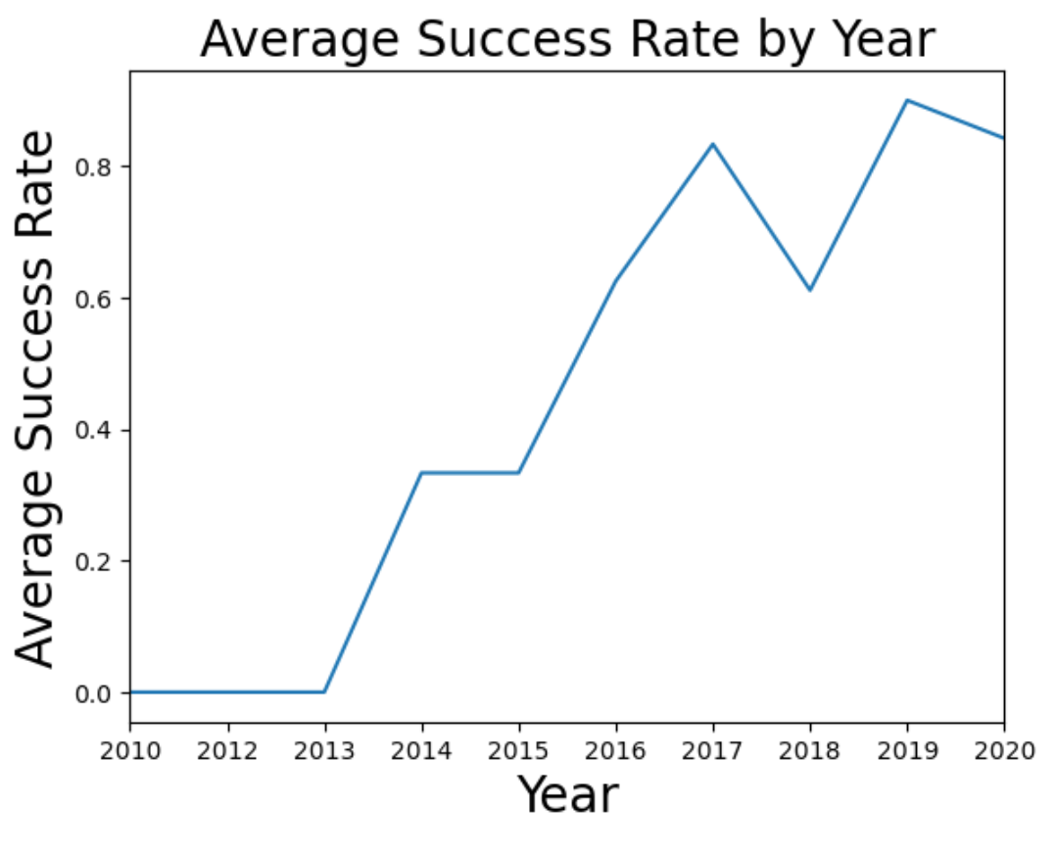
Launch Success Yearly Trend
A line chart of yearly average success rate of launches is shown on the right.

Slide 33
Launch Success Yearly Trend
The average success rate increases year on year from
2013 to 2017.
It drops slightly in 2018 and then increases again in 2019.
It drops in 2020.
There were no successful launches between 2010 and 2013 inclusive either because the launches failed as was the case in 2010, 2012 and 2013 or because there were no launches as was the case in 2011.

Slide 34
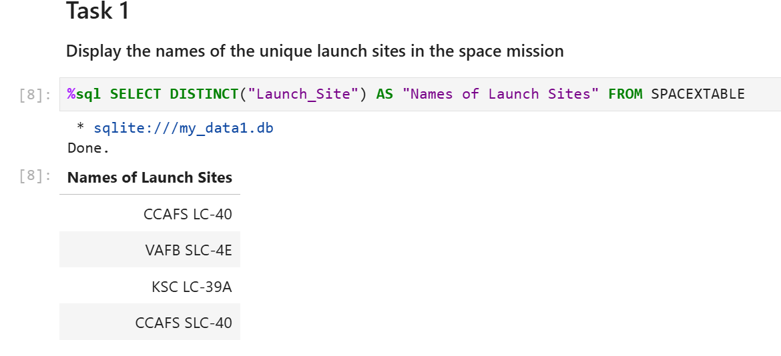
All Launch Site Names
%sql SELECT DISTINCT("Launch Site") AS "Names of Launch Sites" FROM SPACEXTABLE
After loading the SQL extension and establishing a connection with the database, an SQL MAGIC command was used to select the distinct entries occurring under the table column "Launch Site" from the table SPACEXTABLE. The results are:

Slide 35
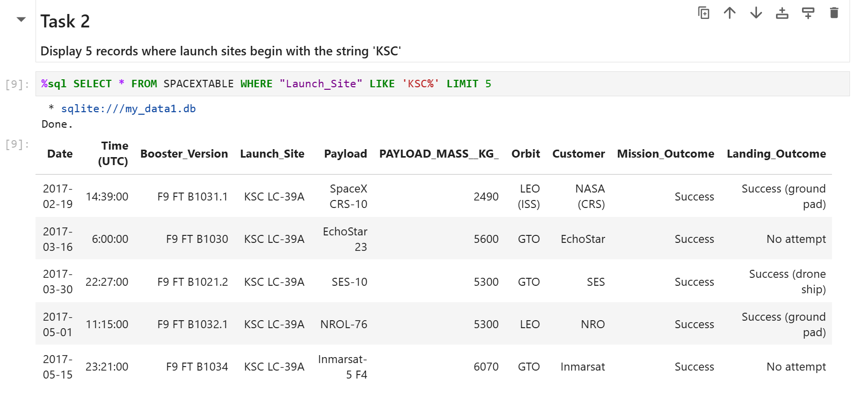
Launch Site Names Begin with 'KSC'
%sql SELECT * FROM SPACEXTABLE WHERE "Launch_Site" LIKE 'KSC%' LIMIT 5
An SQL Magic command was used to select launch sites from SPACEXTABLE whose name begins with the string 'KSC'. Hence, the use of LIKE 'KSC%'. The result of the query was limited to 5 in order to return the top 5 results.
The result returned all the information for the top five results whose launch site is KSC LC-39A

Slide 36
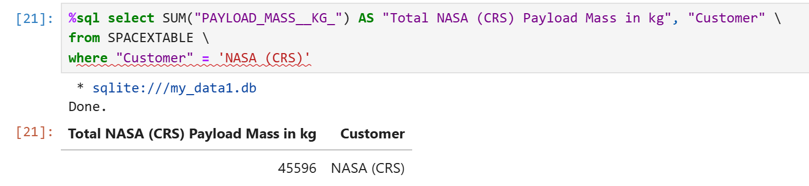
Total Payload Mass
The total payload carried by boosters from NASA (CRS) can be displayed using the query %sql select "PAYLOAD_MASS__KG_", "Customer" FROM SPACEXTABLE WHERE "Customer" = 'NASA (CRS)'
The sum total payload carried by boosters from NASA (CRS) can be calculated using %sql select SUM("PAYLOAD_MASS__KG_") AS "Total NASA (CRS) Payload Mass in kg", "Customer" from SPACEXTABLE where "Customer" = 'NASA (CRS)'
The sum total payload is 45, 596 kg, it is not the individual payload mass carried by each booster which is displayed using the first SQL query above. See the next slide.

Slide 37
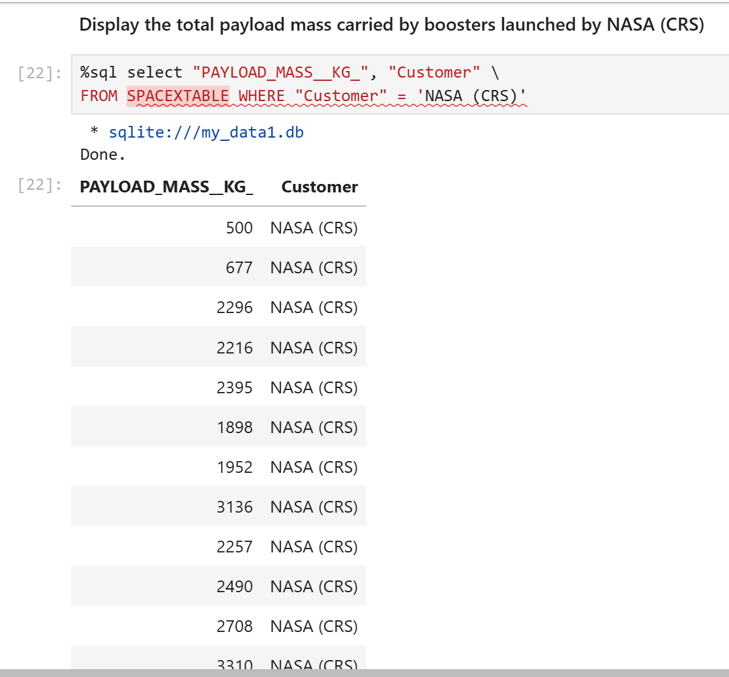
Payload Mass for each NASA booster
The payload for each booster launched by NASA.
The query shown was performed because the request to "Display the total payload mass carried by boosters from NASA (CRS)" differs in meaning from the request to "Calculate the total payload mass carried by boosters from NASA (CRS)"

Slide 38
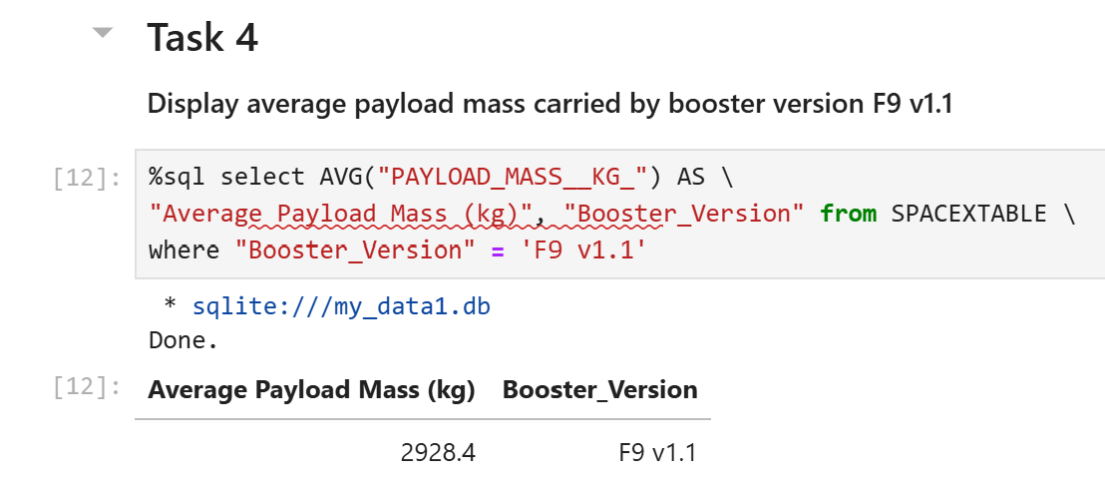
Average Payload Mass by F9 v1.1
%sql select AVG("PAYLOAD_MASS__KG_") AS "Average Payload Mass (kg)", "Booster_Version" from SPACEXTABLE where "Booster_Version" = 'F9 v1.1'
The result is 2,928.4 kg.

Slide 39
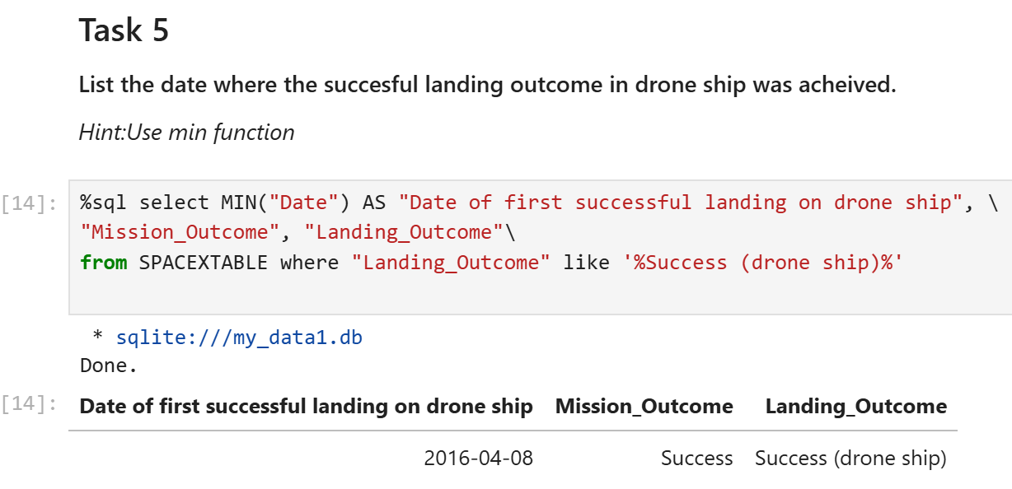
First Successful Drone Ship Landing Date
To find the date of the first successful landing outcome on a drone ship the following SQL query was run.
The SQL query selected the minimum date for which the feature Mission_Outcome is "Success" and the feature Landing_Outcome is like '%Success (drone ship)%'. The use of the % at the beginning and end of the string returns "Success (drone ship)" identically.

Slide 40
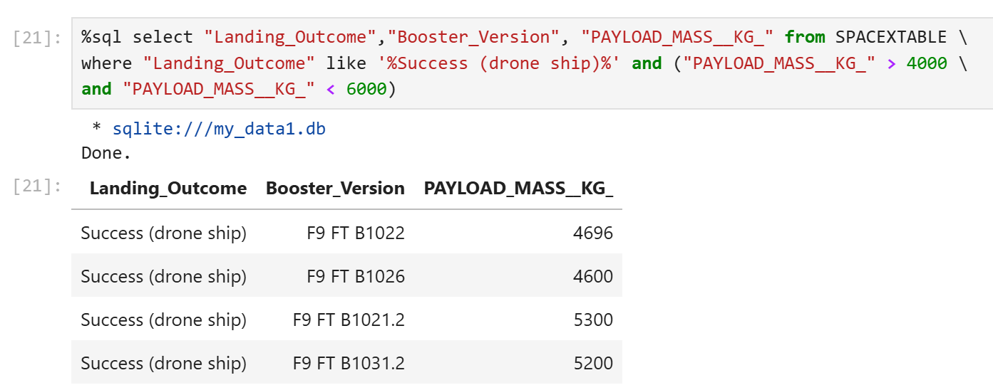
Successful Drone Ship Landing with Payload between 4000 and 6000
The boosters which have successfully landed on drone ship and had payload mass greater than 4000 but less than 6000 are shown in the figure below.
The SQL query selected landing outcomes that were "Success (drone ship)", the booster version for the launch, and the payload mass for such outcomes that are greater than 4,000 kg and less than 6,000 kg. The results are shown in the table and figure below.
Landing Outcome | Booster version | Payload Mass (kg)
Success (drone ship) | F9 FT B1022 | 4696
Success (drone ship) | F9 FT B1026 | 4600
Success (drone ship) | F9 FT B1021.2 | 5300
Success (drone ship) | F9 FT B1031.2 | 5200

Slide 41
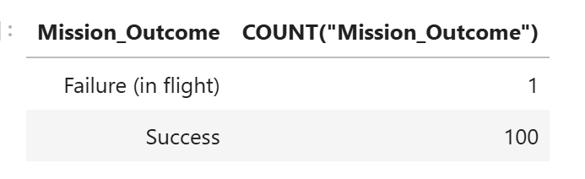
Total Number of Successful and Failure Mission Outcomes
To calculate the total number of successful and failure mission outcomes the following SQL query was performed:
%sql select "Mission_Outcome", COUNT("Mission_Outcome") from SPACEXTABLE \
GROUP BY "Mission_Outcome" like '%Success%'
The query requested to select the feature Mission_Outcome, count the results and to group them according "Mission_Outcome" like '%Success%'. The results are in the figure. There are 100 successful Mission Outcomes and 1 Failure.

Slide 42
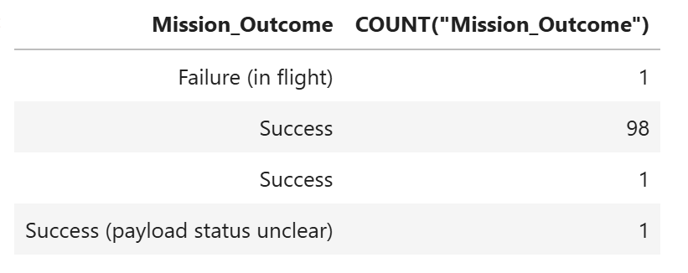
Total Number of Successful and Failure Mission Outcomes
However, a more detailed breakdown of the mission outcomes can be obtained if we run the SQL query
%sql select "Mission_Outcome", COUNT("Mission_Outcome") from SPACEXTABLE \
GROUP BY "Mission_Outcome"
This query does not group "Mission_Outcome" by some set criteria. The results are in the figure. It shows that there are 99 succesful mission outcomes, that one mission outcome labelled as success has a payload status that is unclear, and there is one failure.

Slide 43
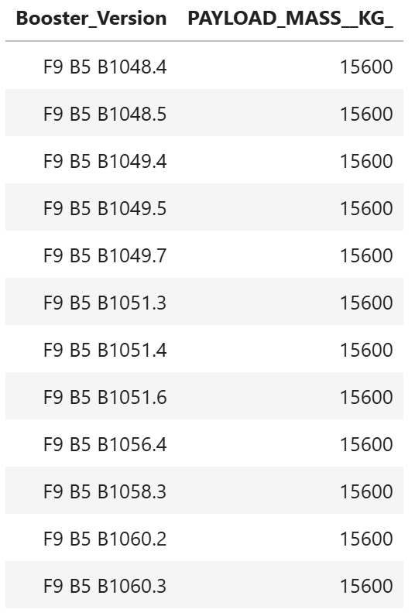
Boosters Carried Maximum Payload
The names of the booster which have carried the maximum
payload mass are:
  F9 B5 B1048.4,F9 B5 B1048.5, F9 B5 B1049.4,
  F9 B5 B1049.5, F9 B5 B1049.7, F9 B5 B1051.3,
  F9 B5 B1051.4, F9 B5 B1051.6, F9 B5 B1056.4,
  F9 B5 B1058.3, F9 B5 B1060.2, F9 B5 B1060.3
These results were found using the subquery
%sql select DISTINCT("Booster_Version"),"PAYLOAD_MASS__KG_" \
from SPACEXTABLE where "PAYLOAD_MASS__KG_" = (SELECT MAX("PAYLOAD_MASS__KG_") from SPACEXTABLE) \
ORDER BY "Booster_Version" ASC
The query selected booster versions having the maximum payload
mass and returned the booster versions in ascending order.

Slide 44
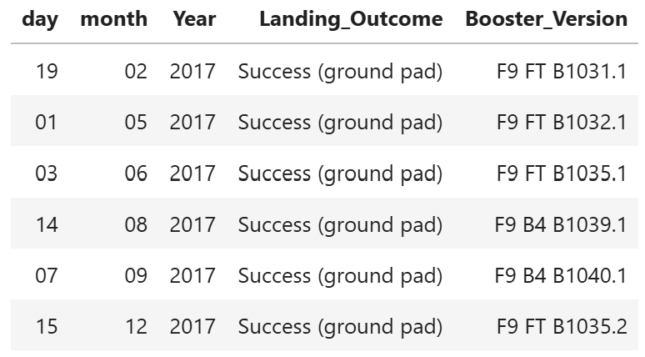
2017 Launch Records
List the records which will display the month names, succesful landing_outcomes in ground pad ,booster versions, launch_site for the months in year 2017:
  %sql select substr(Date, 9,2) as "day", substr(Date,6,2) as "month", substr(Date,0,5) as "Year", "Landing_Outcome", "Booster_Version" from SPACEXTABLE where "Year"='2017' and "Landing_Outcome" like '%Success (ground pad)%'
In the screenshot of the table on the right we
see the booster versions and dates for the
successful landing outcomes in 2017.

Slide 45
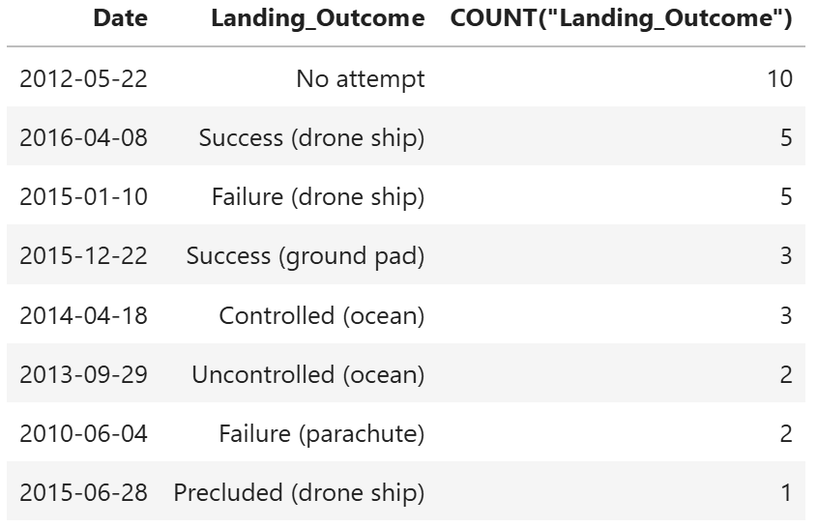
Rank Landing Outcomes Between 2010-06-04 and 2017-03-20
To "rank the count of landing outcomes (such as Failure (drone ship) or Success (ground pad)) between the date 2010-06-04 and 2017-03-20, in descending order" we use the query:
%sql select "Date", "Landing_Outcome", COUNT("Landing_Outcome") \
from SPACEXTABLE where "Date" between '2010-06-04' and '2017-03-20'\
group by "Landing_Outcome" order by count("Landing_Outcome") desc
The query result is shown in the figure.
For 10 launches no attempt was made at
a landing.
On a drone ship landings 5
were successful and 5 failed.
Continued on the next slide.

Slide 46
Rank Landing Outcomes Between 2010-06-04 and 2017-03-20
3 successful ground pad landings
3 controlled ocean landing outcomes,
2 uncontrolled ocean landing
outcomes.
2 Failed landing outcomes involving
a parachute.
1 landing outcome involving a
drone ship which was precluded.

Slide 47

Section 3

Slide 48
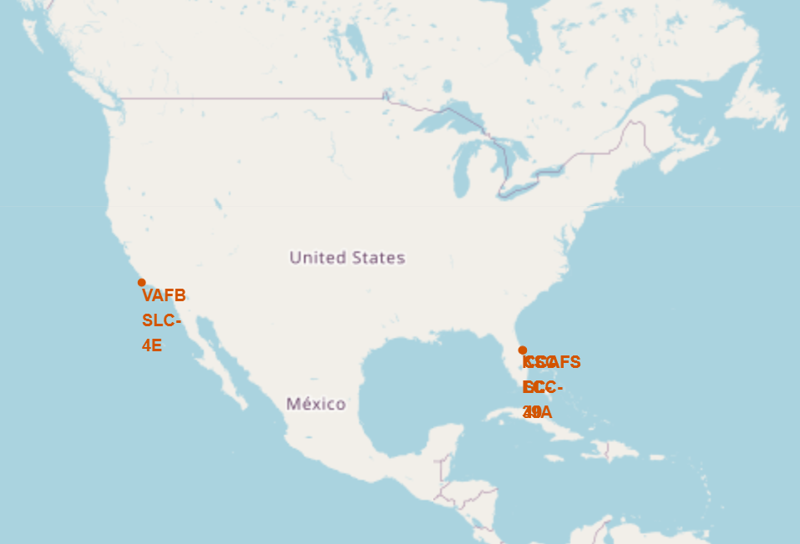
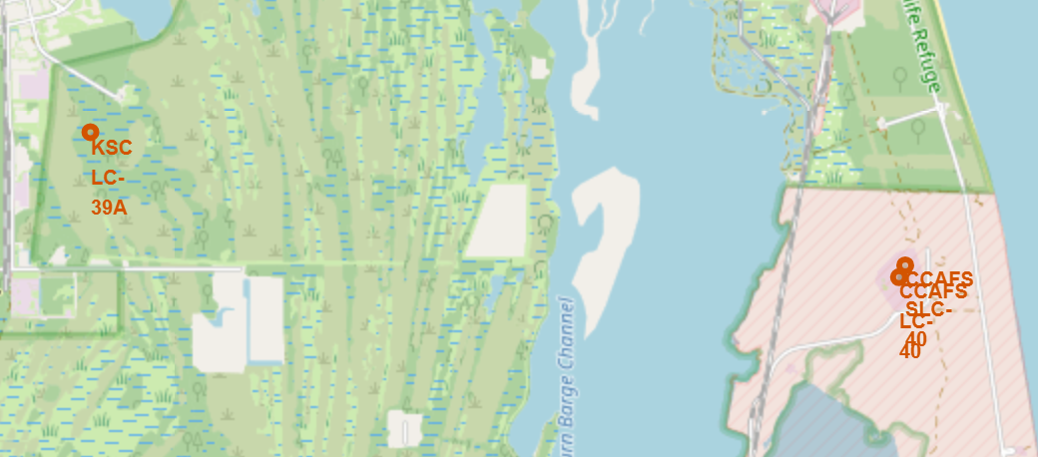
Folium Map including Launch Site location markers
The launch site locations are indicated by red markers on the map.
The launch sites are all close to the coast and the equator. The launch sites are within 35 degrees of the Equator line so as to reduce the influence of Coriolis forces on the rockets at lift off and thereafter.
All launch sites are within proximity to the coast for safety reasons, and possibly others.
Left: The map on the right shows the location of all the launch sites. Right: The map on the left shows the launch sites in Florida (on the East coast of the USA) in more details because they are so class together.

Slide 49
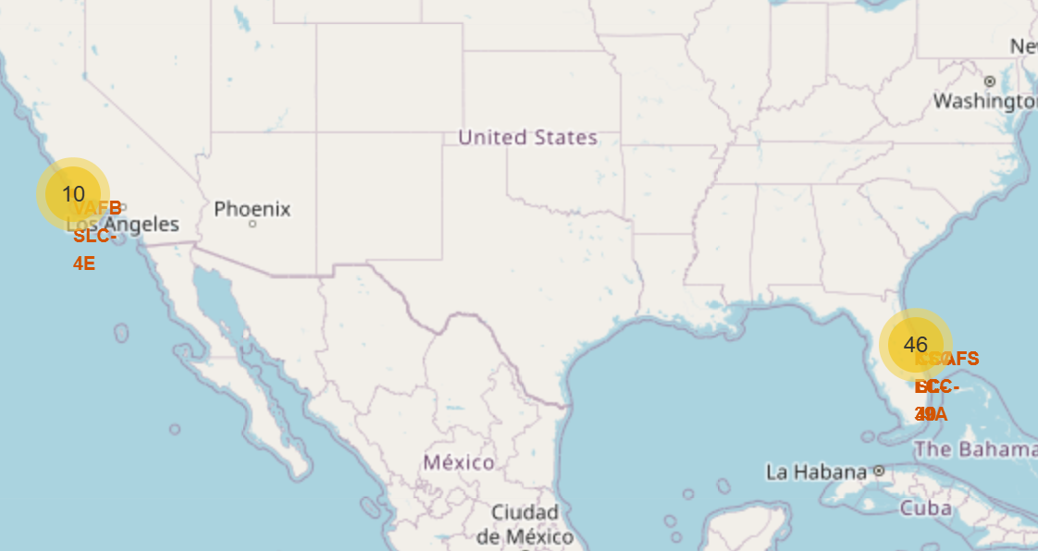
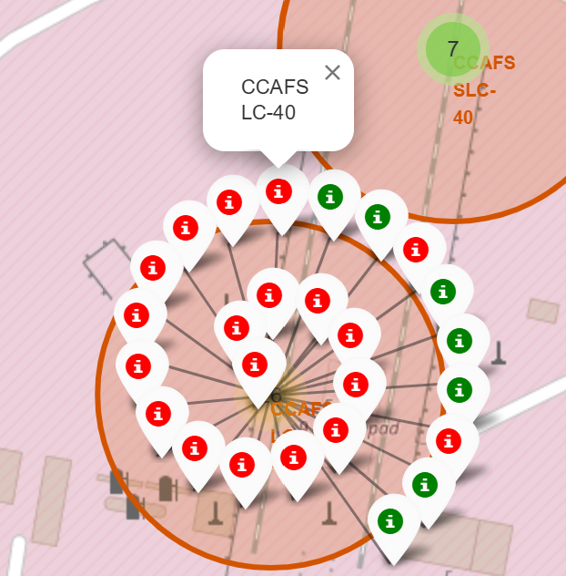
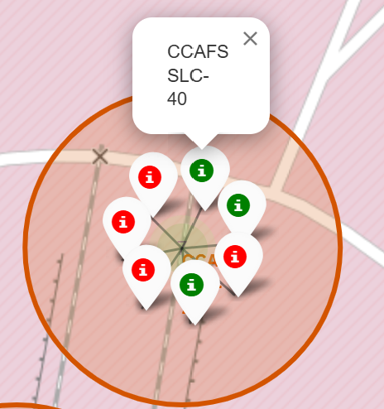
Folium Map of colour coded outcomes
Indicated in the figures are the launches at
VAFB (10) and CCAFS (33) and KSC (13) launch
sites in yellow, with CCAFS launches focused on.
The color-coded launches at CCAFS SLC-40
and CCAFS LC-40 are shown, whilst others
are included in the appendix.
A green label indicates success and a red label
means failure.
At CCAFS LC-40 7/26 (26.9%) launches were
successes. At CCAFS SLC-40 (42.9%) were successful.
Examining Appendix A we see that
  40% of launches at VAFB SLC-4E were successful.
  76.9% of launches at KSC LC-39A were successful.

Slide 50
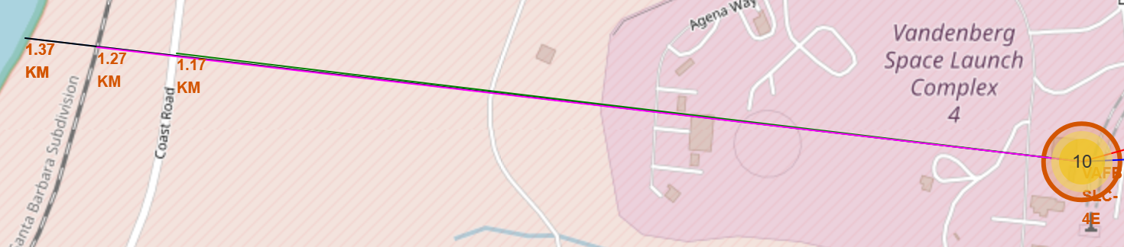
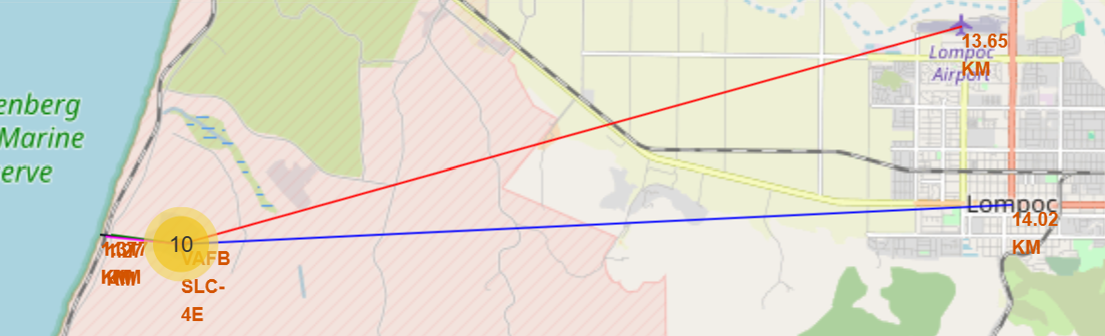
Launch Site Proximities for VAFB SLC-4E
A screenshot of the generated folium map showing the VAFB SLC-4E launch site and its proximities such as railway, highway, coastline, with distance calculated and displayed.
On the next slide the important elements and findings in the
screenshots are discussed.
Distances to the location of the (approximately) nearest coastline (1.37 km, black line), railway (1.27 km, magenta line), highway/road (1.17 km, green line) in the top figure. In the bottom figure the distances to the location of the approximately nearest airport (13.65 km, red line) and city (14.02 km, blue line) are shown.

Slide 51
Launch Site Proximities for VAFB SLC-4E
The following questions, provided in the Jupyter notebook authored by Pratiksha Verma are answered.
  "Are launch sites in close proximity to railways?", "Are launch sites in close proximity to highways?"
  "Are launch sites in close proximity to coastlines?"
Yes, launch sites are in close proximity to railways so that materials can be brought to them.
Yes, launch sites are in close proximity to highways so that materials can be brought to them and that medical teams can reach them if necessary.
Yes, launches sites are close to a coastline so that the rockets are launched over the sea away from population centres, e.g., cities.

Slide 52
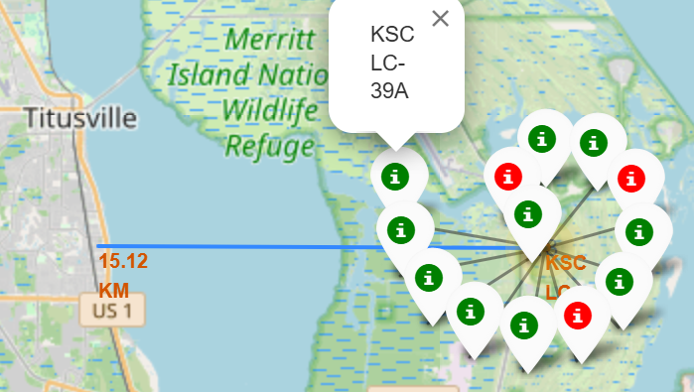
Launch Site Proximity of Titusville to KSC LC-39A
"Do launch sites keep certain minimum distance
away from cities?"
It make sense that launch sites are kept a certain
distance away from cities so as to reduce risk to
human population and because cities would not
have the space to build the launch sites.
We can see that the distance (as the crow flies) from Titusville to KSC LC-39A is
15.12 km, and that the distance from VAFB SLC-4E is 14.02 km.
Whilst I can't say based on the given launch sites what the minimum distance between launch sites and cities is because I only looked at 4 launch sites (the two CCAFS launch sites are further from Titusville than KSC), I would guess that the minimum distance is 14 km.

Slide 53

Section 4

Slide 54
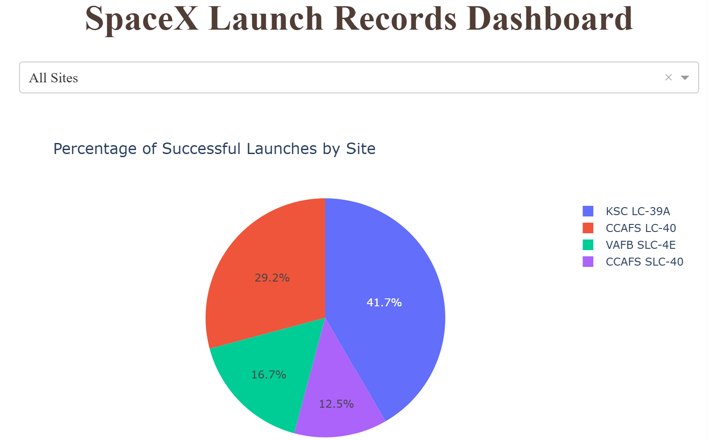
Interactive Dashboard Analysis of SpaceX Launch Records
A screenshot of launch success count for all sites is shown in the pie-chart below.
KSC LC-39A has 41.7%
of successful launches.
CCAFS LC-40 has 29.2%
of successful launches.
VAFB SLC-4E has 16.7%
of successful launches.
CCAFS SLC-40 has 12.5%
of successful launches.
These were produced using
Plotly Dash

Slide 55
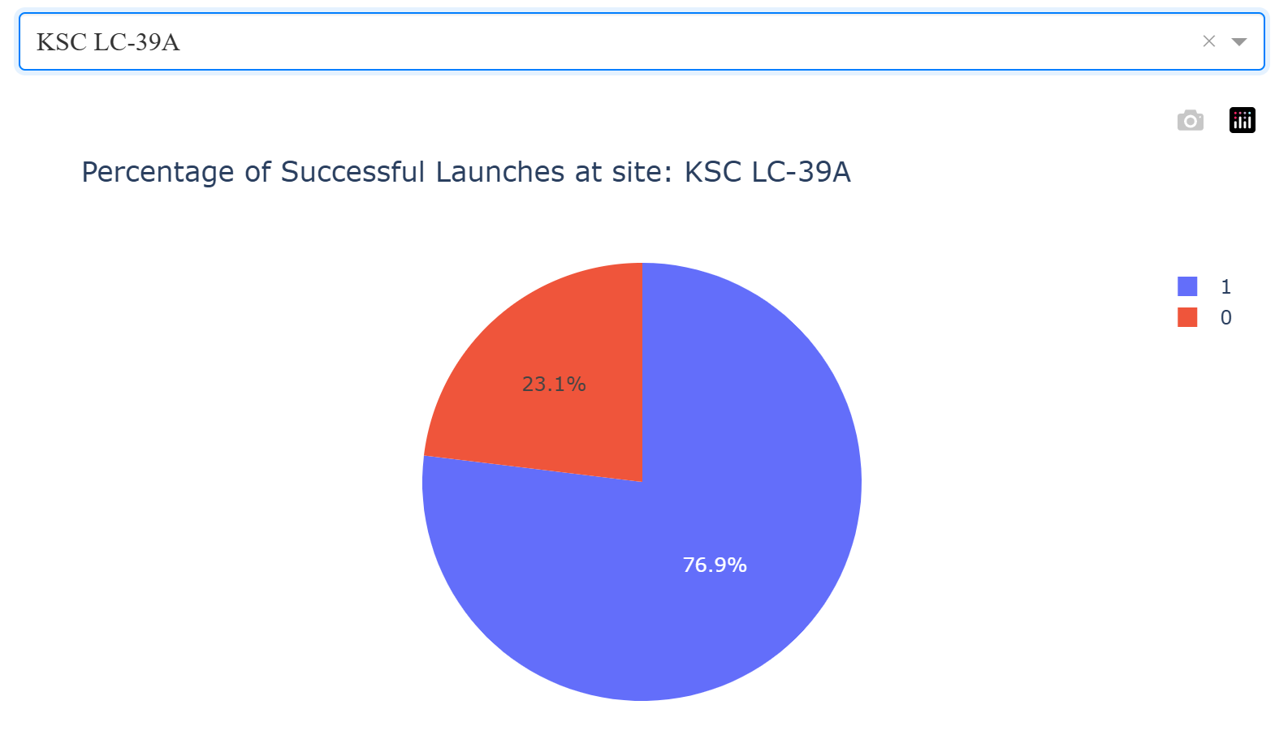
Pie-chart for launch site with highest launch success rate
The launch site with the highest launch success rate is KSC LC-39A. This is shown
in the pie chart.
Successful launches
are recorded as having
class equal to 1. These
represent the blue
section on the pie-chart
and account for 76.9%
of launches.
Failed launches
are recorded as having
class equal to 0. These
represent the red
section on the pie-chart.
These account 23.1% of
launches.

Slide 56
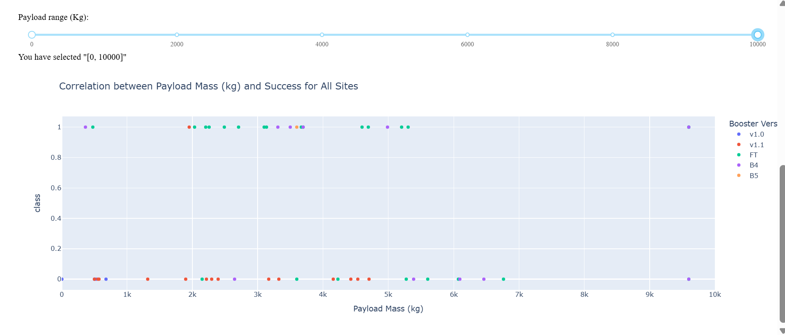
All Sites Scatter Plot of Payload vs. Launch Outcome
Below is a screenshot of Payload vs. Launch Outcome scatter plot for all sites, with payloads between 0 kg and 10000 kg.

Slide 57
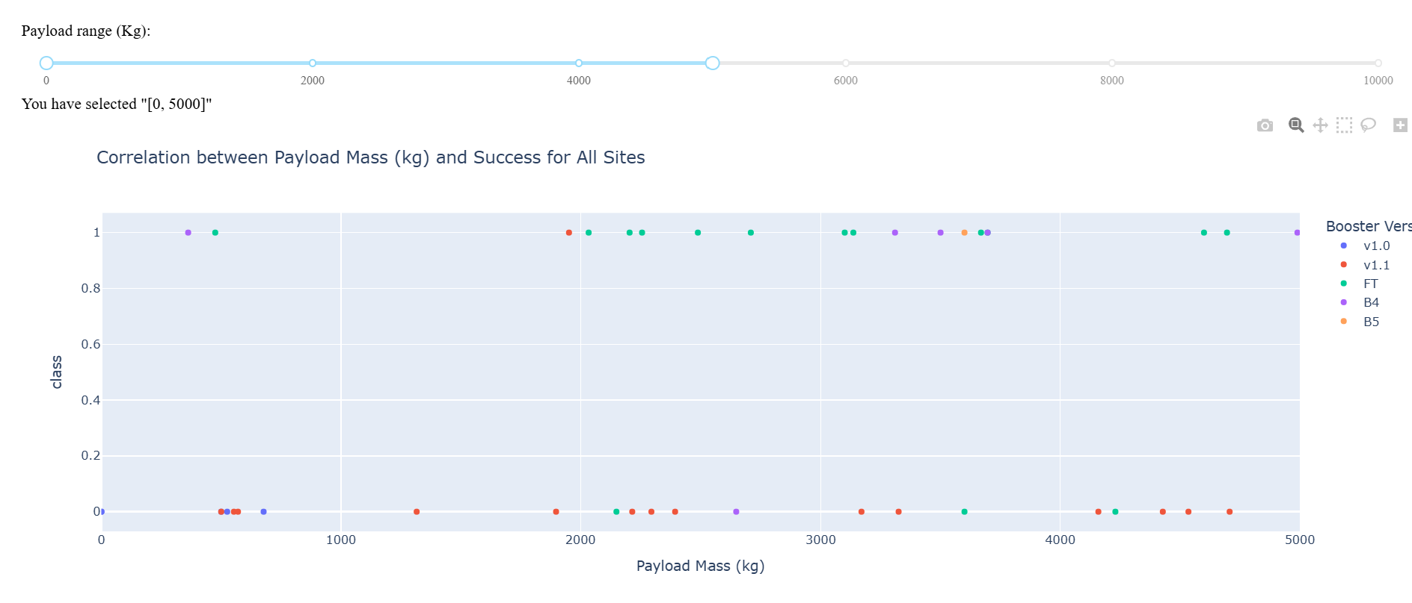
All Sites Scatter Plot of Payload vs. Launch Outcome
A screenshot of Payload vs. Launch Outcome scatter plot for all sites, with payloads between 0 and 5000 kg.

Slide 58
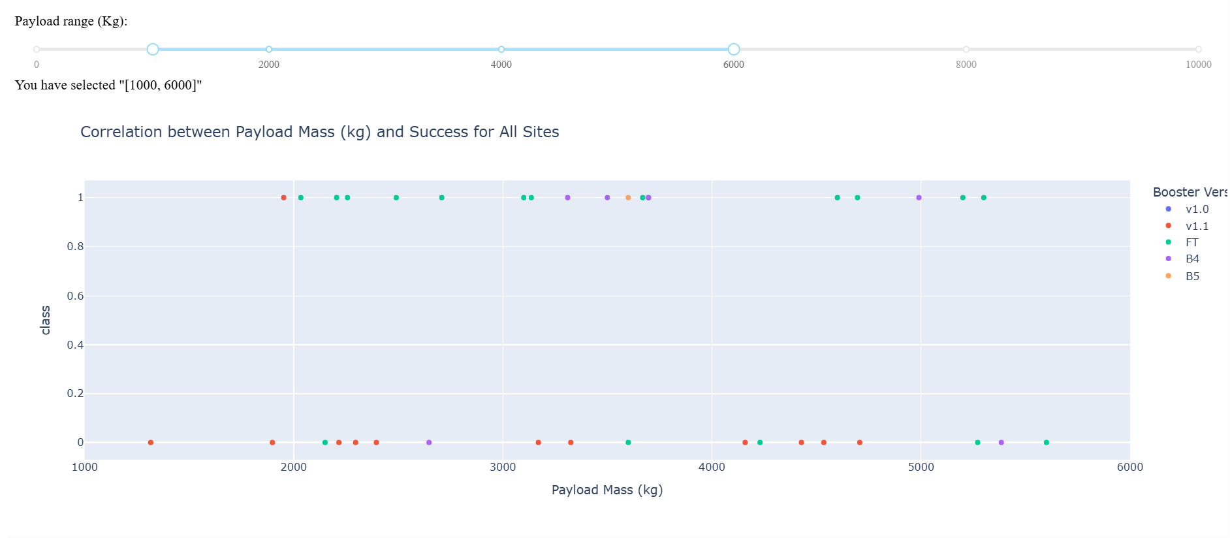
All Sites Scatter Plot of Payload vs. Launch Outcome
Below is a screenshot of Payload vs. Launch Outcome scatter plot for all sites, with payloads between 1000 kg and 6000 kg.
The largest number of launches occurs between 1000 kg and 6000 kg. The booster version most successful in this range is FT, whilst v1.1 is the least successful with 11 failures.

Slide 59
All Sites Scatter Plot of Payload vs. Launch Outcome
On this slide is presented data on the number of successful and failed launches categorized according to booster version for payloads between 0 and 10000 kg.
Clearly, the FT booster version is the most successful in this range.
Booster Version | Successful launches | Failed launches
v1.0 | 0 | 2
v1.1 | 1 | 13
FT | 13 | 7
B4 | 6 | 5
B5 | 1 | 0

Slide 60

Section 5

Slide 61
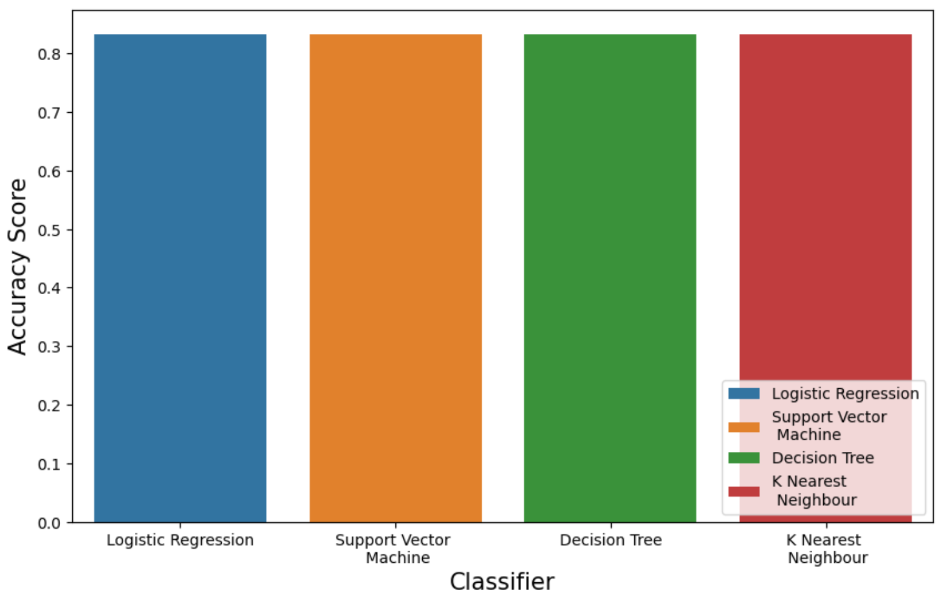
Classification Accuracy
The accuracy for each classification model is shown above. The bar chart on the right shows in more detail which model is the most accurate.
The models Logistic Regression, Support Vector Machine, Decision Tree, and K-Nearest Neighbour all have the same accuracy score of 0.8333.
This is due to lack of data. More data would enable better modelling.

Slide 62
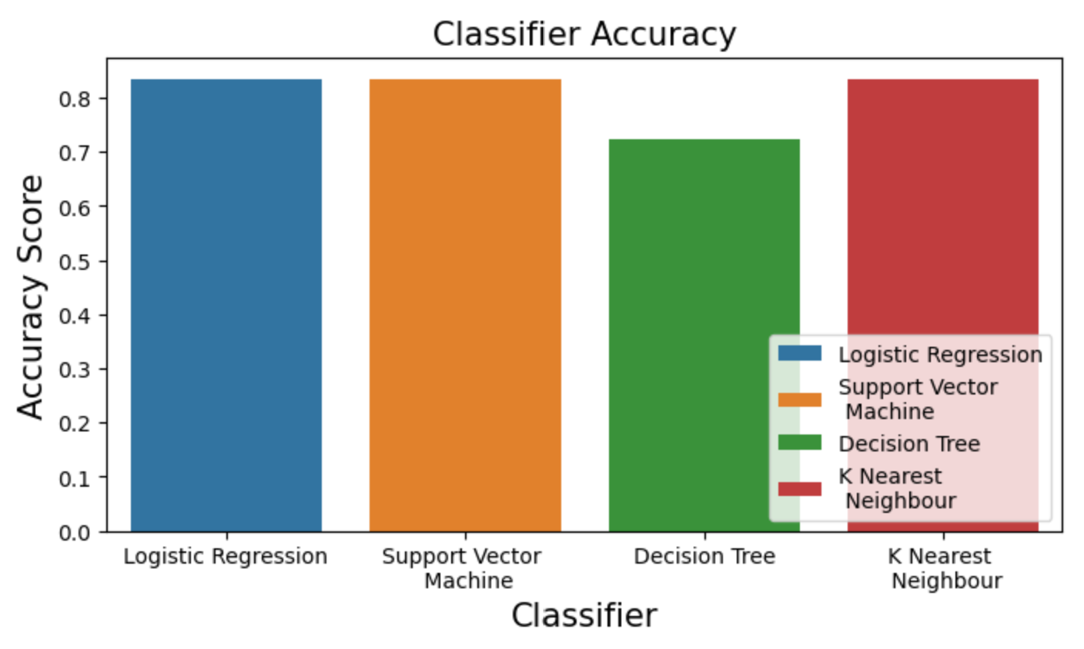
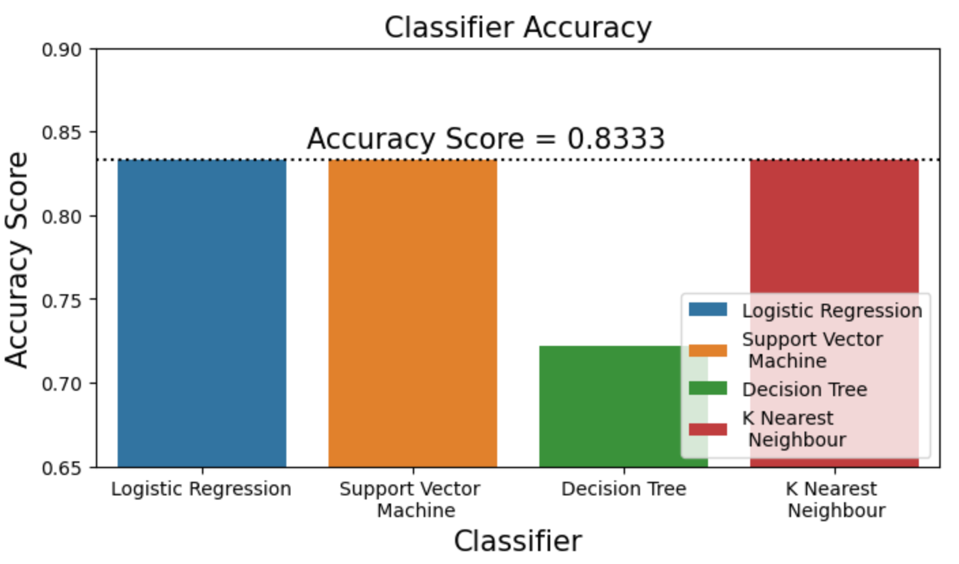
Classification Accuracy
Aside: It should be noted that on some runs of the code that the Decision Tree classifier model performs better than the others and returns an accuracy score of 72% (as shown above) or even 67%, or 94% (not shown). So, the Decision Tree classifier result seems unreliable for the given data.

Slide 63
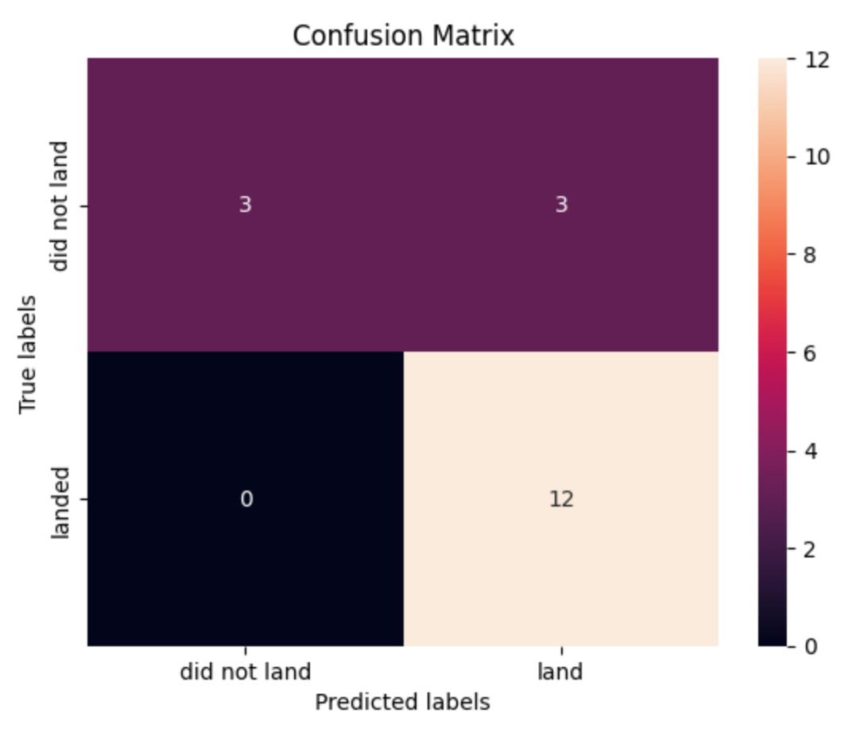
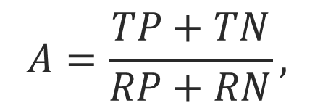
Confusion Matrix
The confusion matrix below is that for the Logistic Regression, Support Vector Machine, and K-Nearest Neighbour classification models. All had the same number of true positives and true negatives.
We find that of the test samples, the models
yield an accuracy score (A)
where TP stands for true positives, TN stands
for true negatives, RP stands for real/actual
positives, and RN stands for real/actual negatives.
We have TP = 12, TN = 3, RP + RN = 18.
So, A = 15/18 = 0.8333.
$$A=\frac{TP+TN}{RP+RN},$$

Slide 64
Conclusions
The booster version used plays a large role in predicting if the first stage of the Falcon 9 rocket will land successfully.
Based on the Plotly Dashboard it seems that the Falcon 9 FT booster is the most successful one since it landed successfully 65% of the time, but this only a subset of the data since it only covers payloads between 0 kg and 10000 kg, whereas there were payloads having mass between 0 and 15600 kg in the SQL exploratory data analysis, but the majority of launches have a payload of less than 10000 kg.
Other booster versions did have successful mission outcomes, but these not as reliable as the FT booster.
The launches at KSC LC-39A were successful 76.9% of the time compared to 42.9% at CCAFS SLC-40, 40% at VAFB SLC-4E and 26.9% at CCAFS LC-40.
All launches, except one, with payloads greater than 10000 kg were successful.
The Logistic Regression, Support Vector Machine, the Decision Tree, K-Nearest Neighbour classifier models predicted with an accuracy score of 83.333% when applied to the test data. It should be noted that on some runs of the code that the Decision Tree classifier model performs better or less than the others and returns an accuracy score of between 67% and 94%, so this classifier seems unreliable.
It was not possible to determine the cost of a launch because no data concerning costs was available.

Slide 65
Acknowledgements
Firstly, I thank my parents for their love and support. Otherwise, I would not have finished this project.
Secondly, thank you to all the support staff at IBM Skills Network who have answered my questions and helped resolve any technical issues and misconceptions that arose whilst completing this certificate.
Thank you to all those who have help me in any other way.

Slide 66
References
API: https://cf-courses-data.s3.us.cloud-object-storage.appdomain.cloud/IBM-DS0321EN-SkillsNetwork/datasets/API_call_spacex_api.json
Webscraping: https://en.wikipedia.org/w/index.php?title=List_of_Falcon_9_and_Falcon_Heavy_launches&oldid=1027686922
Datawrangling: https://cf-courses-data.s3.us.cloud-object-storage.appdomain.cloud/IBM-DS0321EN-SkillsNetwork/datasets/dataset_part_1.csv
EDA: https://cf-courses-data.s3.us.cloud-object-storage.appdomain.cloud/IBM-DS0321EN-SkillsNetwork/datasets/dataset_part_2.csv
SQL: https://cf-courses-data.s3.us.cloud-object-storage.appdomain.cloud/IBM-DS0321EN-SkillsNetwork/labs/module_2/data/Spacex.csv
Folium: https://cf-courses-data.s3.us.cloud-object-storage.appdomain.cloud/IBM-DS0321EN-SkillsNetwork/datasets/spacex_launch_geo.csv
Plotly Dash: https://dash.plotly.com/
Machine Learning 1: https://cf-courses-data.s3.us.cloud-object-storage.appdomain.cloud/IBM-DS0321EN-SkillsNetwork/datasets/dataset_part_2.csv
Machine Learning 2: https://cf-courses-data.s3.us.cloud-object-storage.appdomain.cloud/IBM-DS0321EN-SkillsNetwork/datasets/dataset_part_3.csv
Machine learning discussion: https://discussions.edx.org/course-v1:IBM+DS0720EN+2T2021/posts/63610e098149fd04c87a38ce

Slide 67
Appendix A:
All of the notebooks used in this project can be found on my GitHub page for this project and are linked to in the relevant slides.
All of the datasets used in this project can be found on my GitHub page.

Slide 68
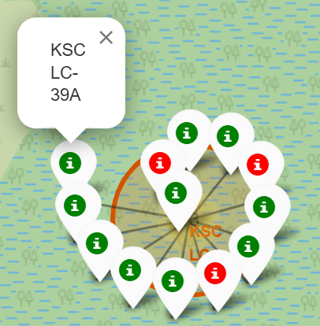
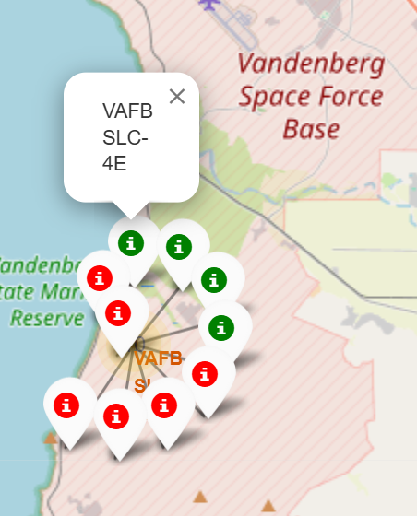
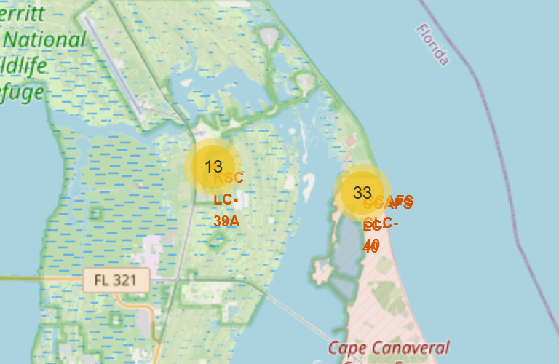
Appendix B: Folium color-coded map of all launch outcomes
Florida, USA
launches
California, USA
launches

Slide 69


